Slide 1
Kubernetes
Atul Kahate

Slide 2
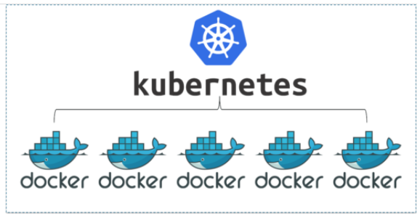
Container Orchestration

Slide 3
Why Container Orchestration?
Requirement: We want 10 instances of Microservice (See next slide) A container, 15 instances of Microservice B container and ....
Typical Features:
Auto Scaling - Scale containers based on demand
Service Discovery - Help microservices find one another
Load Balancer - Distribute load among multiple instances of a microservice
Self Healing - Do health checks and replace failing instances
Zero Downtime Deployments - Release new versions without downtime

Slide 4
Microservice Application
An application built from several small, specialized, independent parts that work together to make a meaningful application
Example: An e-commerce application
Web frontend
Catalogue
Shopping cart
Authentication
Logging
Persistence
Each of these individual services is called as a microservice
Each is coded and owned by a different team, has its own release and deployment cycle and can be scaled differently
Each will run as a separate container

Slide 5
Container Orchestration Options
Docker Swarm
Apache Mesos
Cattle, Nomad, Empire
AWS ECS (Elastic Container Service)
Kubernetes
EKS (Elastic Container Service for Kubernetes)
AWS Fargate

Slide 6
Kubernetes Introduction

Slide 7
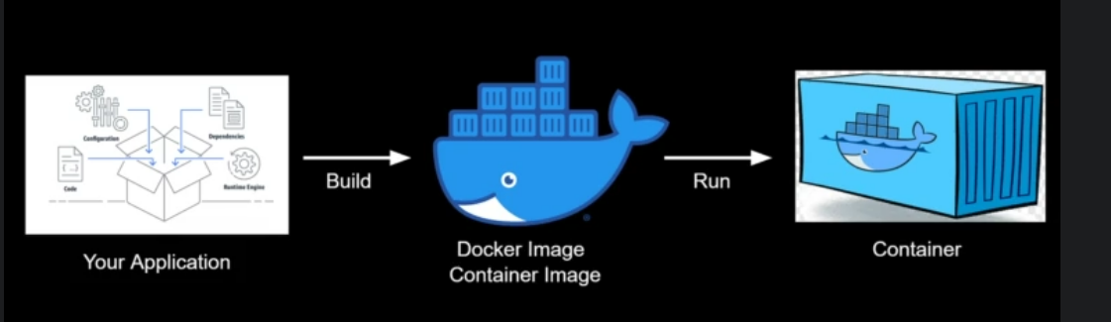
Basic idea

Slide 8
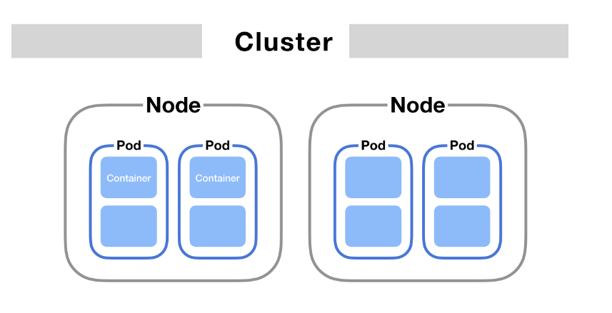
Kubernetes Components

Slide 9
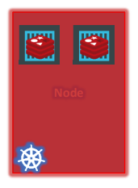
Node (Minion)
Node: A physical or virtual machine on which Kubernetes is installed.
It is a master or worker machine.
Kubernetes will launch containers on worker machines.
Since a node can go down, we need multiple nodes for handling failures.

Slide 10
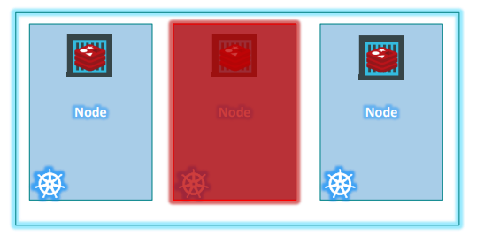
Cluster
Cluster is a set of node machines
Generally has one master node (control plane) and one or more worker nodes, but may also have multiple master nodes.
Even if one node fails, the other takes over.
Also helps in load balancing.

Slide 11
Master and Worker Nodes
Master Node(s)
Manages Cluster
Worker Node(s)
Runs Our Applications
Kubernetes Cluster

Slide 12
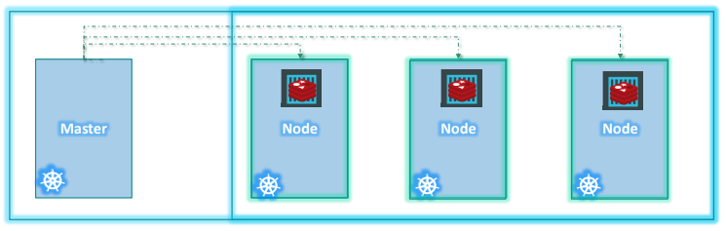
Master
Manages a cluster.
Monitors nodes and handles failures.
Performs the actual orchestration of containers on the worker nodes.

Slide 13
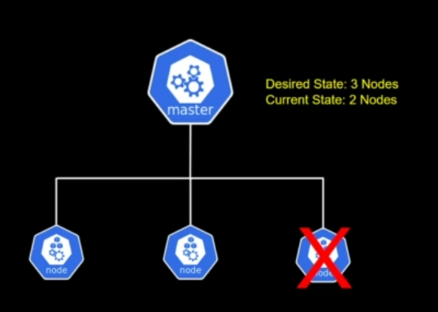
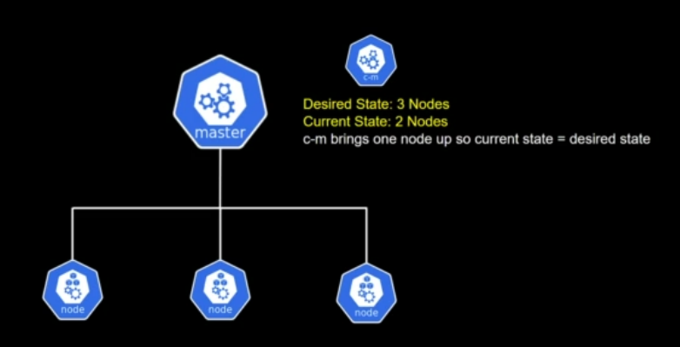
Example

Slide 14
Pod

Slide 15
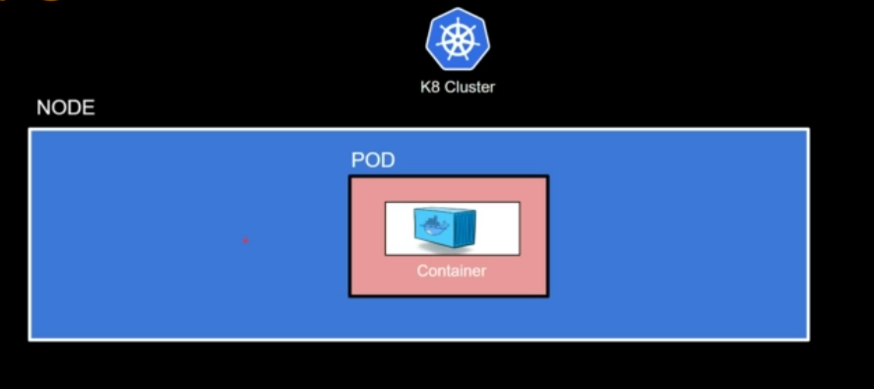
Pod Concept
Kubernetes does not deploy containers directly on the worker nodes.
A container is encapsulated into a Kubernetes object called as Pod.
Pod = A Single instance of an application
A Pod is the smallest object that we can create in Kubernetes.
Remember NPC – Node contains Pod contains Container

Slide 16
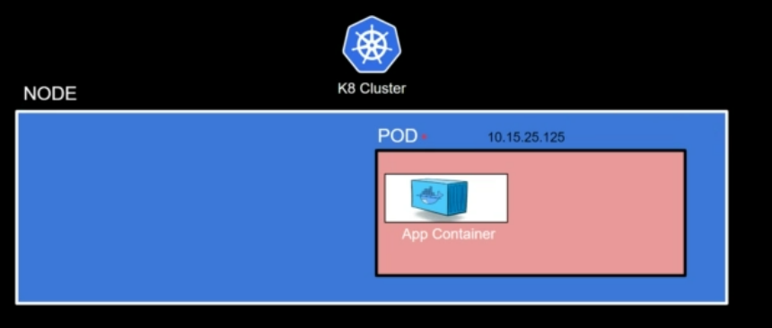
Each Pod has a unique IP address

Slide 17
A Pod is Immutable
A pod cannot be changed when it is running, hence it is immutable
This is because a container is immutable and a pod encapsulates a container

Slide 18
Pod Creation
Initial state – A container is running inside a pod on a node
Node
Pod
IP address a:b:c:d
Container

Slide 19
Pod Scaling Up
Need to scale up – A new pod comes up with an identical container
Now two pods are running with identical containers on two different IP addresses
Node
Pod
IP address a:b:c:d
Pod
IP address p:q:r:s
Container
Container

Slide 20
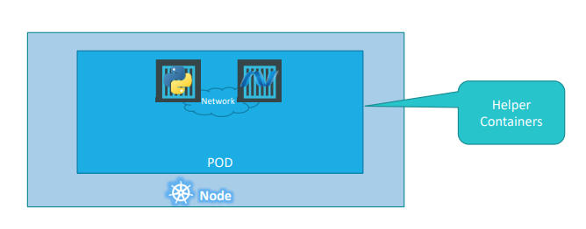
Multi-container Pods
A pod can have multiple containers under one condition – the containers must be different.
Example: A web application has a helper application to perform some key tasks.
Now they can refer to each other as localhost and share storage space.

Slide 21
Replicaset and Deployment

Slide 22
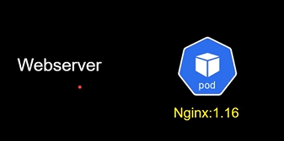
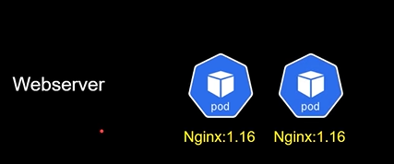
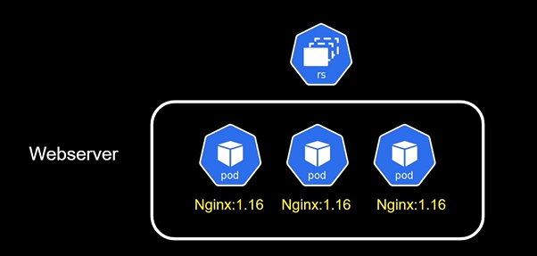
Replicaset concept
Suppose we are running a web server
To make it highly available, we run another instance
and so on …
To manage this concept better, we use a replicaset, so that if one instance goes down, another one is automatically started

Slide 23
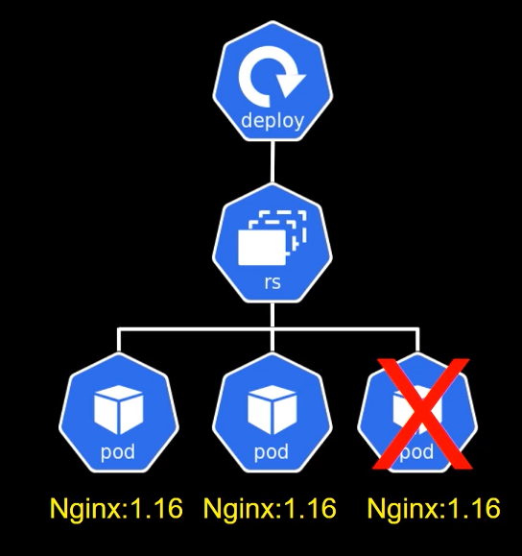
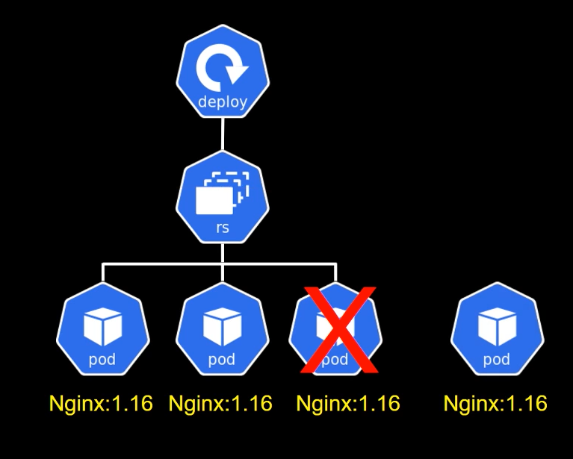
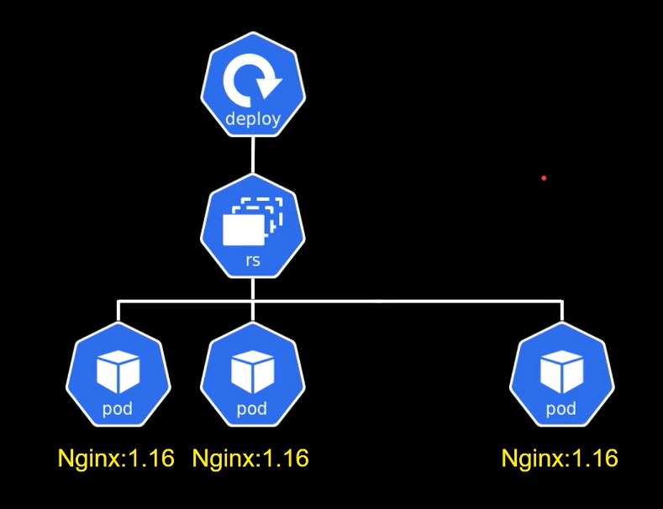
Replicaset – Key idea
If an instance goes down, replicaset will spin another one automatically
Desired state of instances is restored

Slide 24
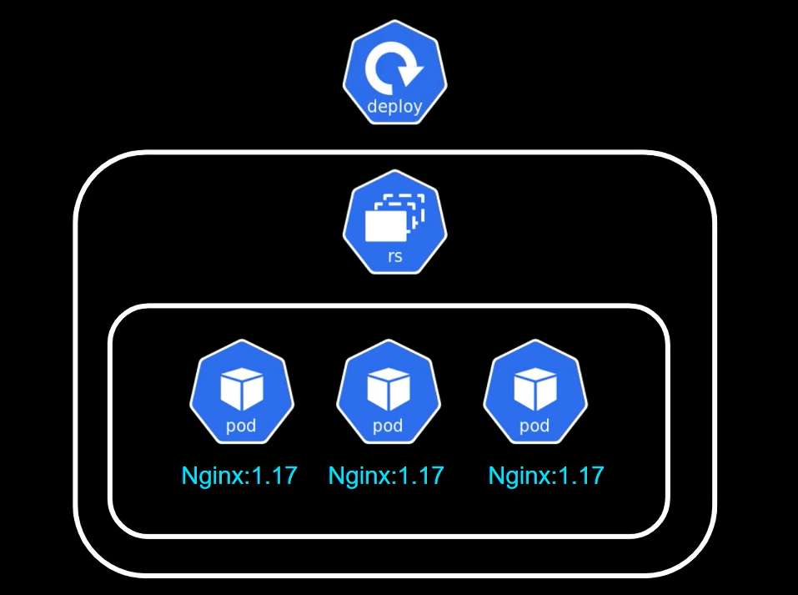
Deployment concept
What if we want to upgrade to version 1.17? Replicaset cannot help here
We need deployment

Slide 25
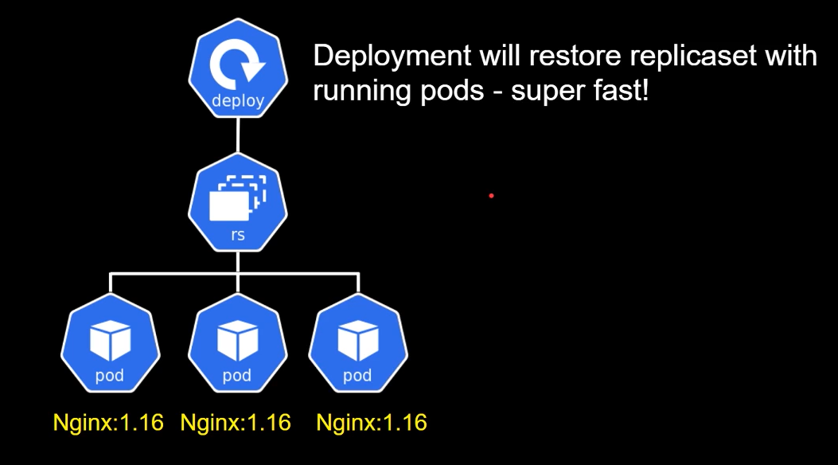
Deployment - Key Idea
Replicaset restores pods
Deployment restores replicaset with running pods

Slide 26
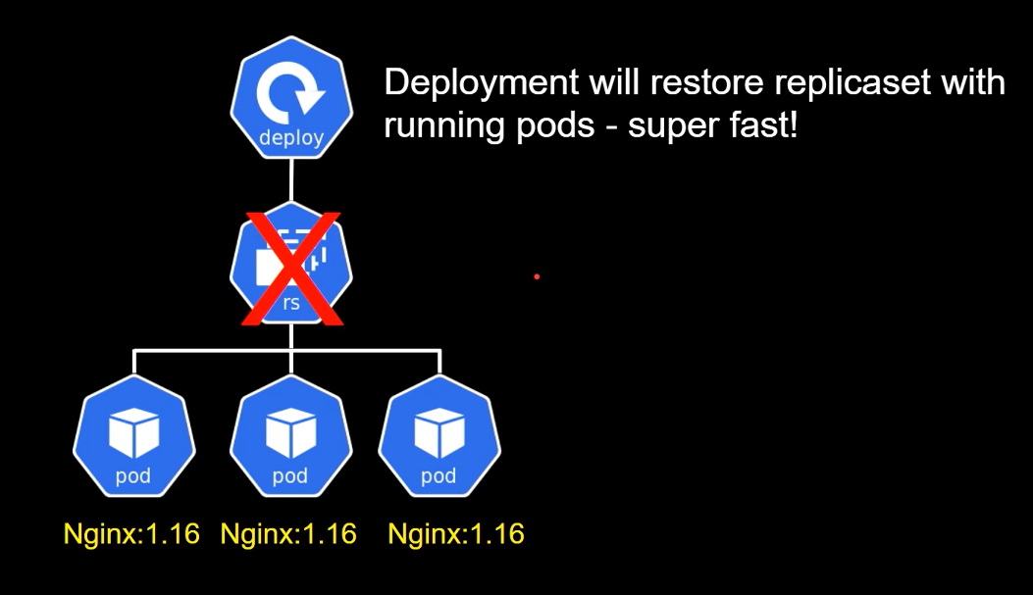
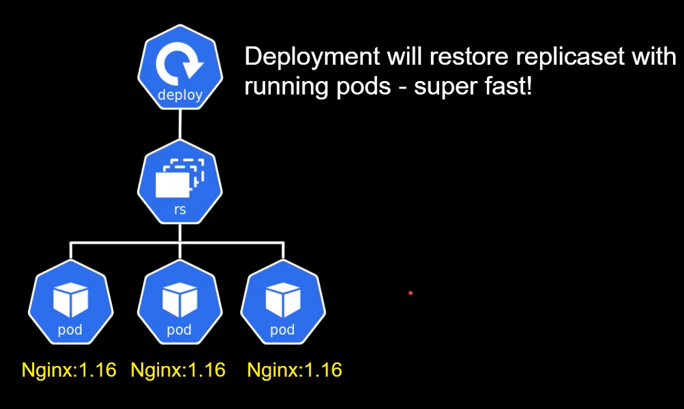
Deployment and Replicaset
Suppose a replicaset goes bad
Deployment will restore it

Slide 27
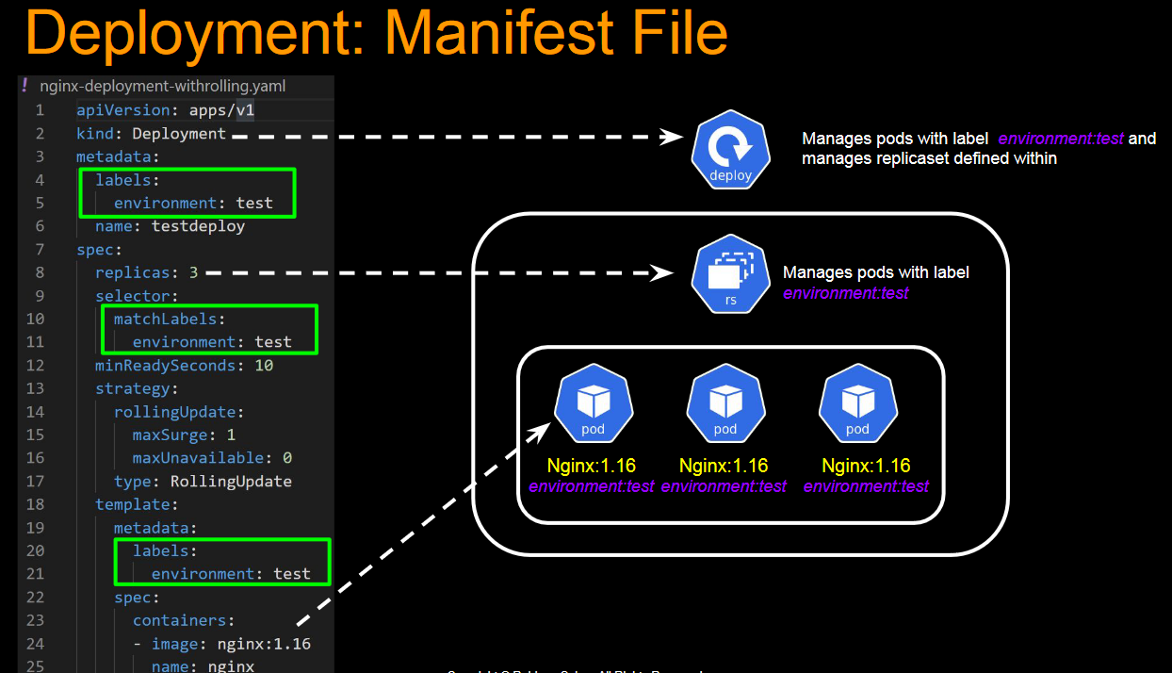
How is all this linked?

Slide 28
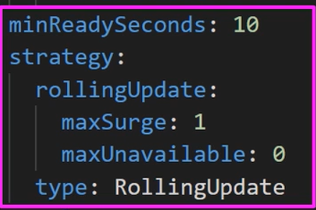
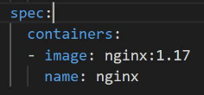
Now the other part of the manifest file
Deals with upgrades/version changes
Suppose we change from version 1.16 to 1.17

Slide 29
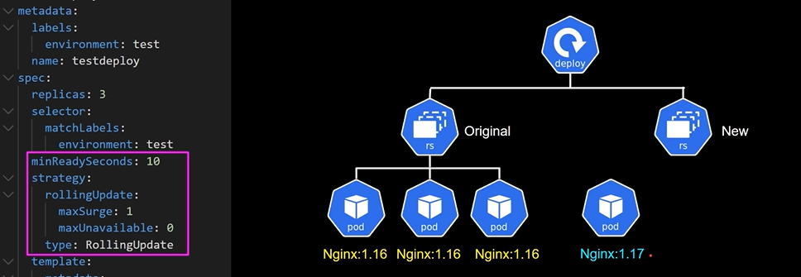
Upgrade to a new version – 1
A new replicaset containing one pod for the new version will be created first
So, 4 copies of the pod are running: 3 for the old version, 1 for the new version
Why 1 for the new version? Because maxSurge says 1
How long will this continue? 10 seconds – Why? minReadySeconds is set to 10

Slide 30
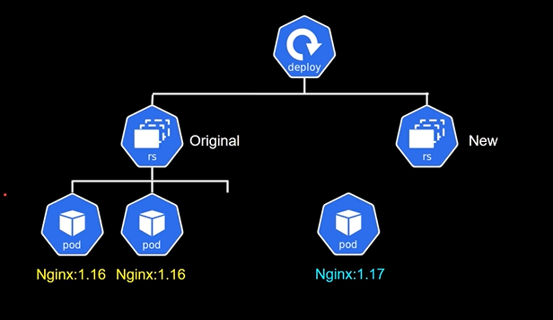
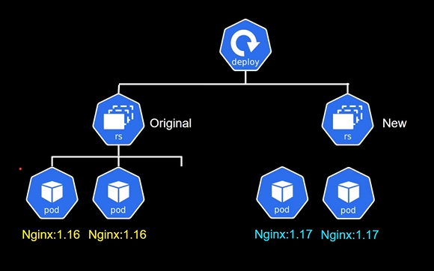
Upgrade to a new version – 2
After 10 seconds, if the new version pod is running fine, one of the old pods will be deleted
Then, a second new pod will come up

Slide 31
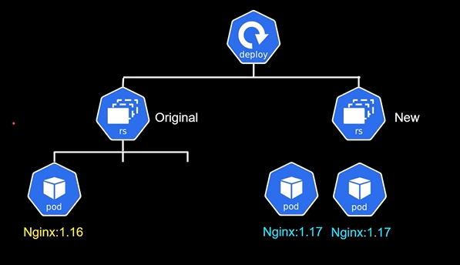
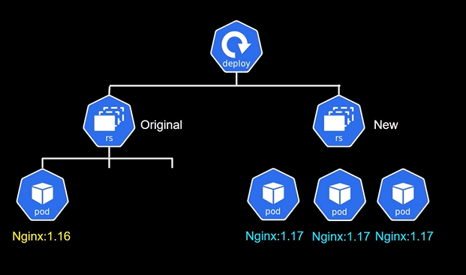
Upgrade to a new version – 3
After another 10 seconds, another old version pod will be deleted
Its place will be taken up by a new version pod

Slide 32
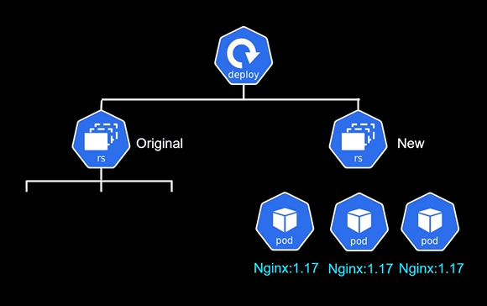
Upgrade to a new version – 4
Finally, after another 10 seconds the last old pod will be removed
Now, we can delete the old replicaset, and it will get deleted
But if we attempt to delete the new replicaset, it will be automatically restored

Slide 33
Kubernetes Setup

Slide 34
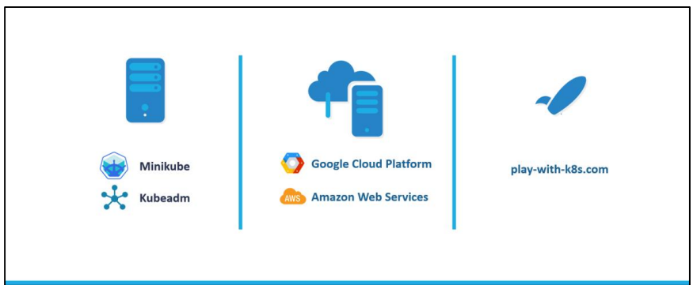
Various Options (Individual, Cloud, Web)

Slide 35
Minikube
Usually in a production cluster setup you will have multiple master and worker nodes on separate machines.
But what if you want to test something on your local machine or try something out? Setting up the whole cluster would be difficult or even impossible.
Minikube is a utility you can use to run Kubernetes (k8s) on your local machine.
It creates a single node cluster contained in a virtual machine (VM).
This cluster lets you demo Kubernetes operations without requiring the time and resource-consuming installation of full-blown K8s.
Kubectl, the command line tool for Kubernetes, then enables the interaction with the cluster: to create pods, services and other components.

Slide 36
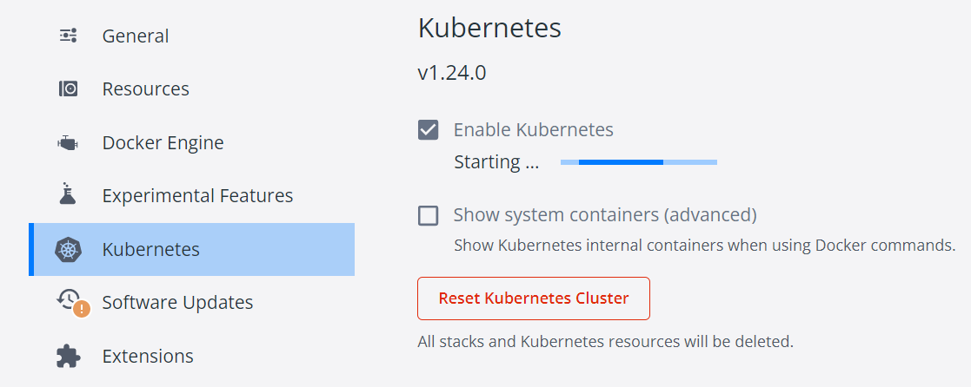
Simplest Option: Use Docker Desktop
Right click on Docker Desktop, select Kubernetes, Check Enable Kubernetes, Apply and Restart

Slide 37
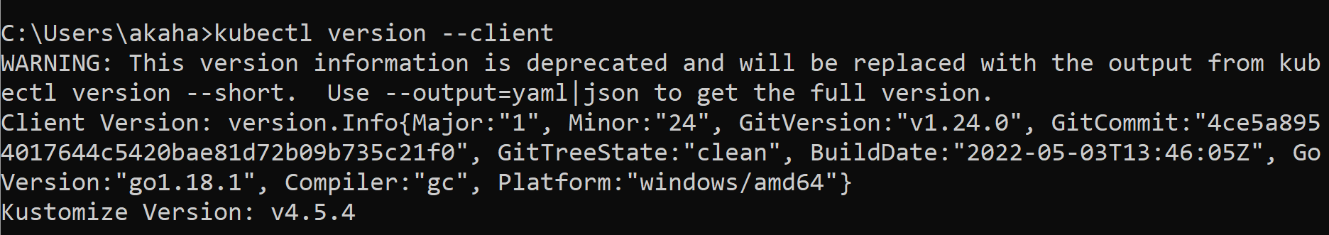
Download kubectl utility (Works on any Kubernetes installation, Cloud-neutral also)
Go to https://kubernetes.io/docs/tasks/tools/install-kubectl-windows/
Download kubectl.exe (https://dl.k8s.io/release/v1.24.0/bin/windows/amd64/kubectl.exe)
Check version: kubectl version --client

Slide 38
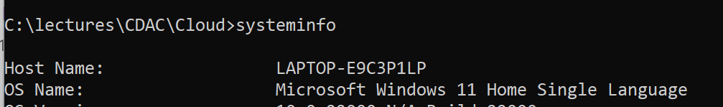
If Docker Desktop option did not work: Download and Install Minikube
https://minikube.sigs.k8s.io/docs/start/ and https://storage.googleapis.com/minikube/releases/latest/minikube-installer.exe
Run the installer
Check if Virtualization is supported on the machine by running the systeminfo command

Slide 39
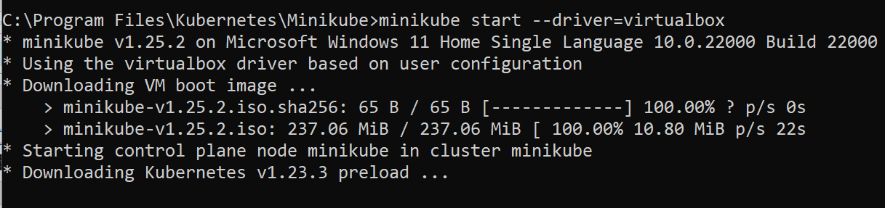
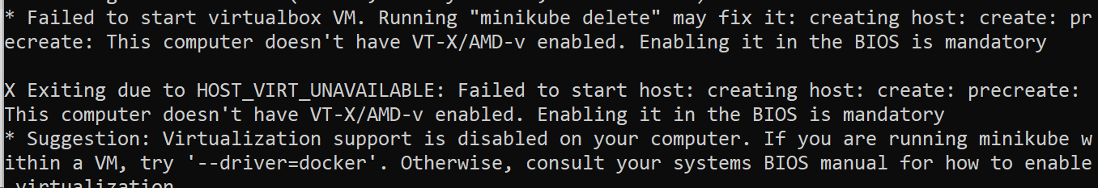
Start minikube (Run as administrator) – Error?
minikube start

Slide 40
Troubleshooting
If your minikube VM asks for user id and password,
Id: docker
Password: tcuser
If it gives an error Unable to connect to the server: dial tcp …
In the command prompt on the host/base machine:
minikube stop
minikube delete
minikube start

Slide 41
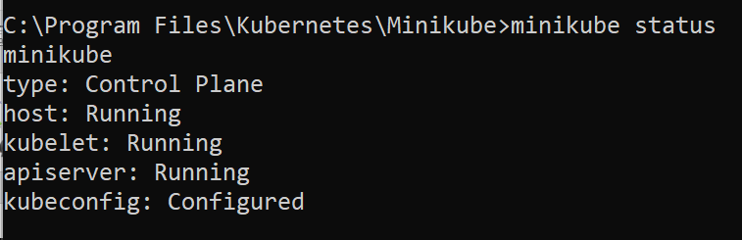
Check Status (Run as administrator)
minikube status

Slide 42
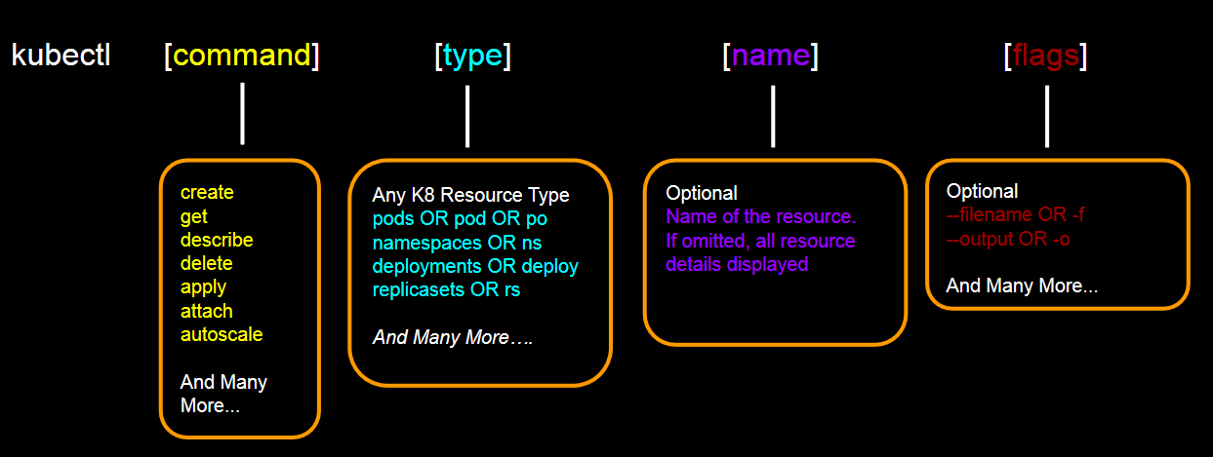
kubectl command

Slide 43
To Delete Everything
kubectl delete all --all

Slide 44
Simplest Tutorial
https://kubernetes.io/docs/tutorials/hello-minikube/

Slide 45
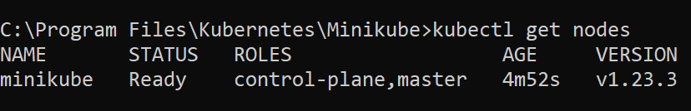
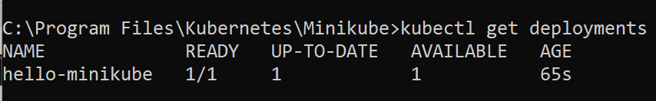
Get Details of the Kubernetes Cluster (Ref: https://kubernetes.io/docs/tutorials/hello-minikube/)
kubectl get nodes
Do a sample deployment: kubectl create deployment hello-minikube --image=k8s.gcr.io/echoserver:1.10
Check deployments: kubectl get deployments

Slide 46
Get Details of the Kubernetes Cluster – if using Docker Desktop for Kubernetes
Expose the deployment as a service: kubectl expose deployment hello-minikube --type=LoadBalancer --port=8080
Get the URL of the exposed service:
kubectl port-forward service/hello-minikube 7080:8080

Slide 47
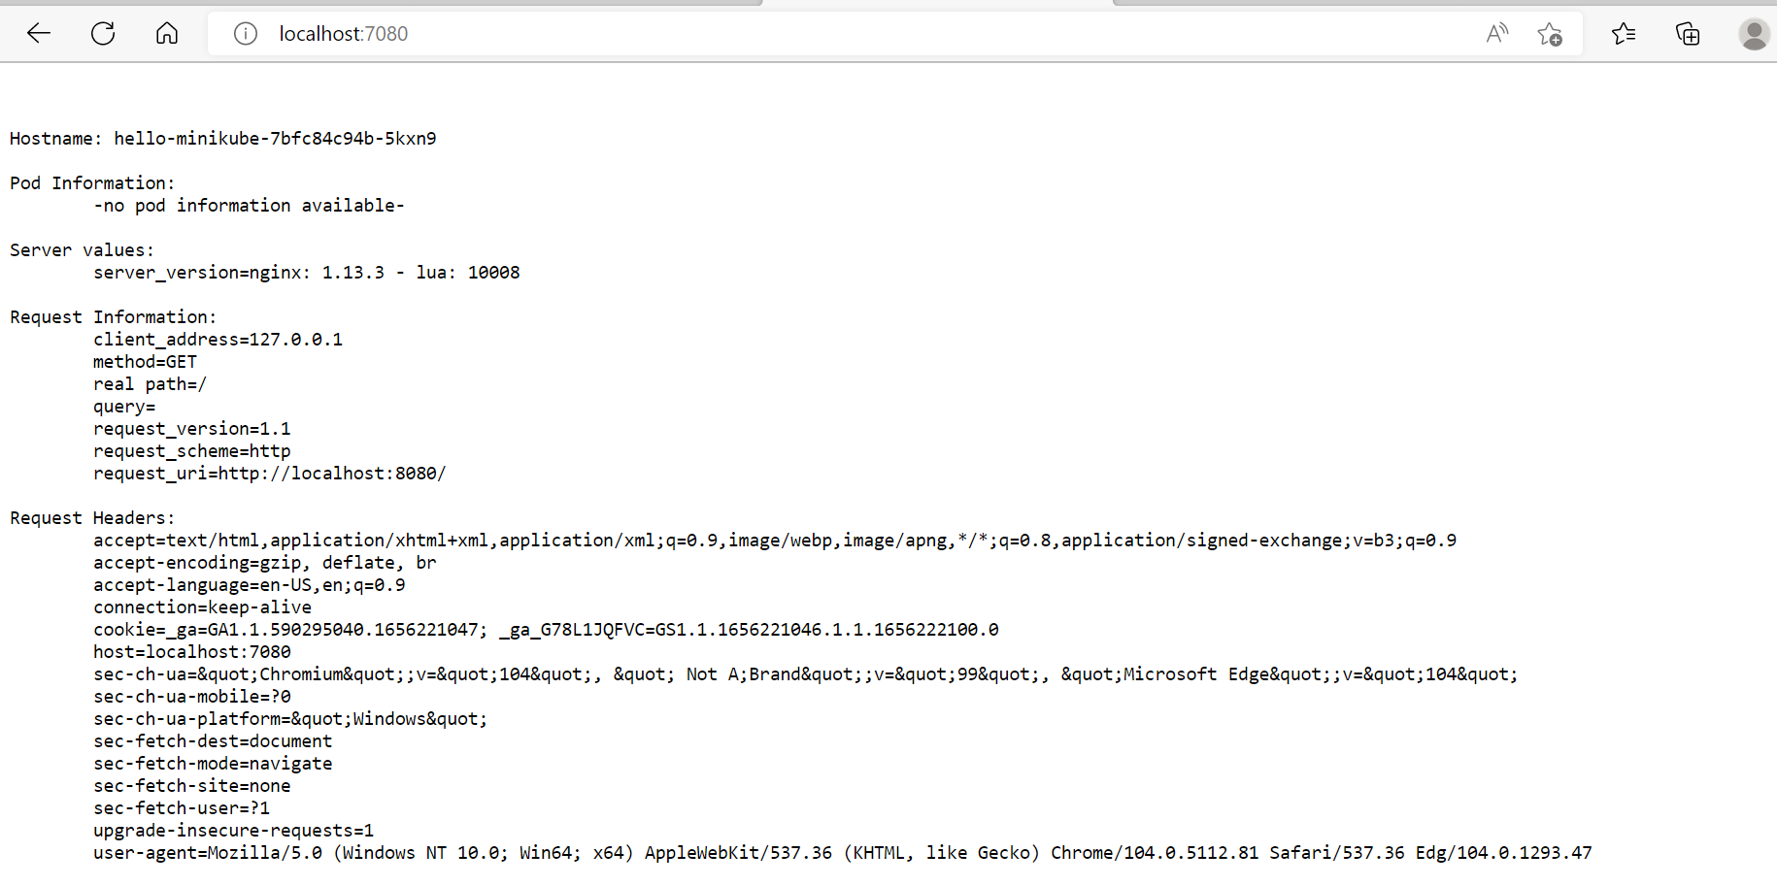
Test: http://localhost:7080/

Slide 48
OTHERWISE: Get Details of the Kubernetes Cluster
Expose the deployment as a service: kubectl expose deployment hello-minikube --type=LoadBalancer --port=8080
Get the URL of the exposed service:
minikube service hello-minikube --url

Slide 49
Delete the hello-minikube Service
kubectl delete services hello-minikube
kubectl delete deployment hello-minikube

Slide 50
Kubernetes Python Example

Slide 51
Steps and Pre-requisites
Steps
Run the application locally
Create an image and run the application in Docker
Create a deployment and run the application in Kubernetes
Pre-requisites
Docker and Kubernetes installed
Python

Slide 52
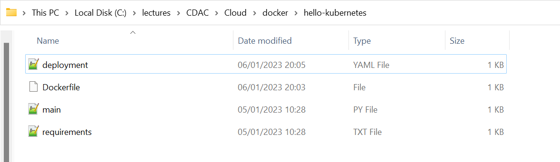
Get the Application Code
Open directory C:\lectures\CDAC\Cloud\docker\hello-kubernetes

Slide 53
Application Code – main.py
from flask import Flask
app = Flask(__name__)
@app.route("/")
def hello():
return "Hello from Kubernetes!"
if __name__ == "__main__":
app.run(host='0.0.0.0')

Slide 54
Application Code – requirements.txt
Flask

Slide 55
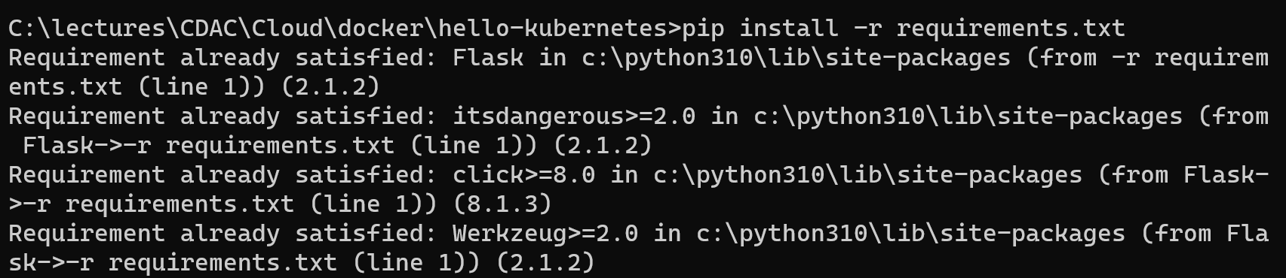
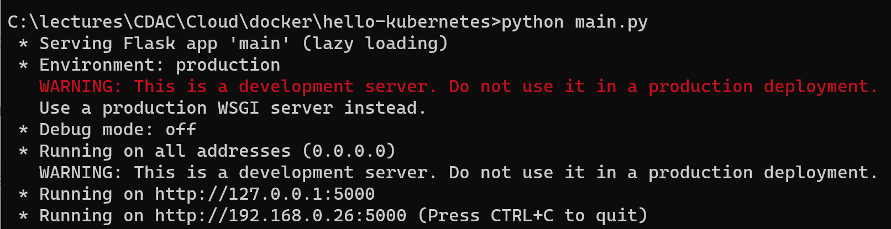
Run locally
pip install -r requirements.txt
python main.py

Slide 56
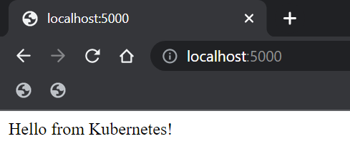
Test: localhost:5000

Slide 57
Create Dockerfile (C:\lectures\CDAC\Cloud\docker\hello-kubernetes)
FROM python:3.7
WORKDIR /app
COPY . /app
RUN pip install -r requirements.txt
EXPOSE 5000
CMD ["python", "/app/main.py"]

Slide 58
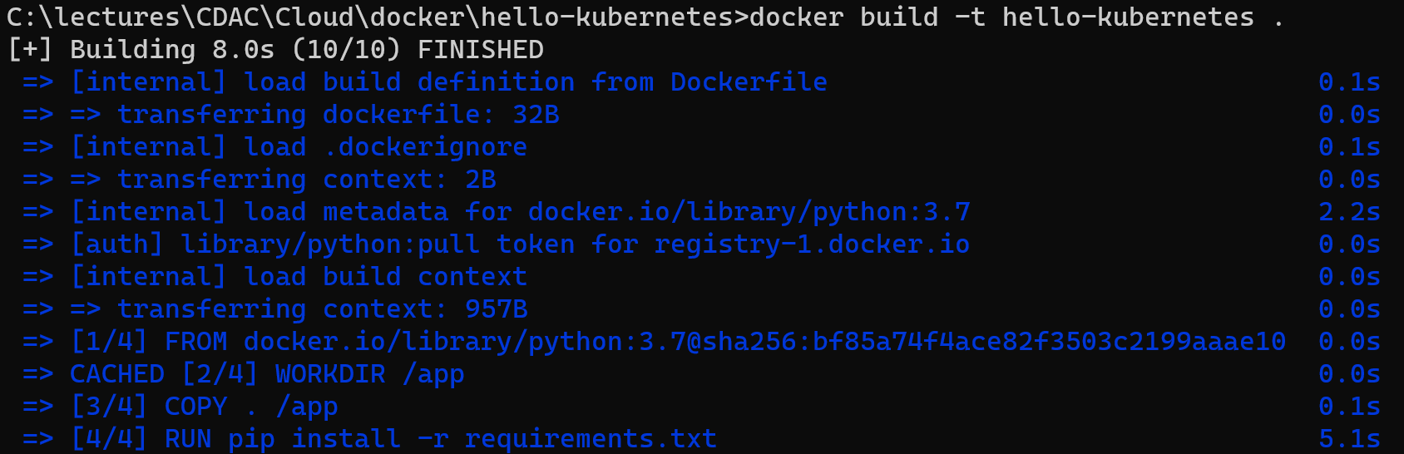
Create Docker Image
docker build -t hello-kubernetes .

Slide 59
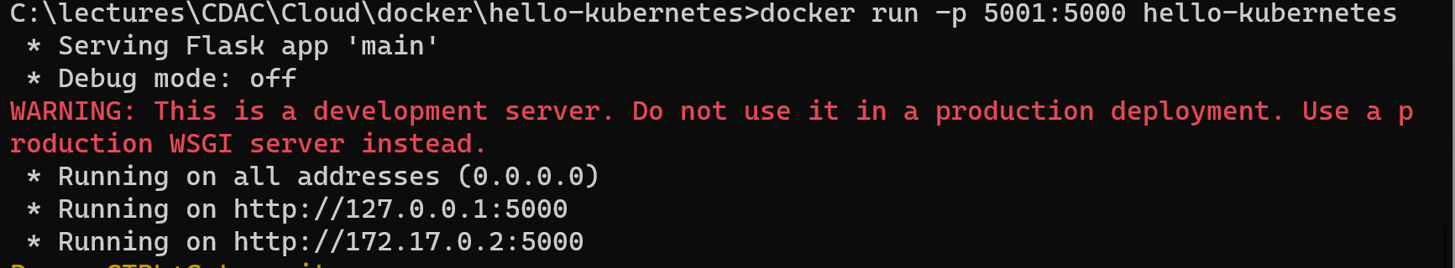
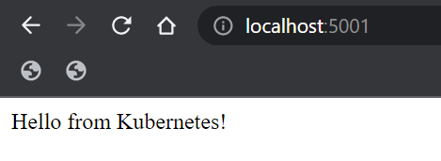
Test Docker Container
docker run -p 5001:5000 hello-kubernetes
http://localhost:5001

Slide 60
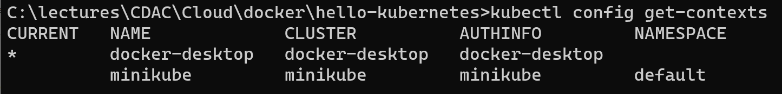
Now on to Kubernetes …
First check what all Kubernetes contexts are available
kubectl config get-contexts
If it is not already current, change the context to docker-desktop:
kubectl config set current-context docker-desktop
kubectl config get-contexts

Slide 61
Create deployment.yaml file (C:\lectures\CDAC\Cloud\docker\hello-kubernetes)
apiVersion: v1
kind: Service
metadata:
name: hello-kubernetes-service
spec:
selector:
app: hello-kubernetes
ports:
- protocol: "TCP"
port: 9999
targetPort: 5000
type: LoadBalancer
---
apiVersion: apps/v1
kind: Deployment
metadata:
name: hello-kubernetes
spec:
selector:
matchLabels:
app: hello-kubernetes
replicas: 4
template:
metadata:
labels:
app: hello-kubernetes
spec:
containers:
- name: hello-kubernetes
image: hello-kubernetes
imagePullPolicy: Never
ports:
- containerPort: 5000

Slide 62
YAML Configurtation Details
We want a load-balanced service exposing port 9999
We want 4 instances of the hello-kubernetes container running

Slide 63
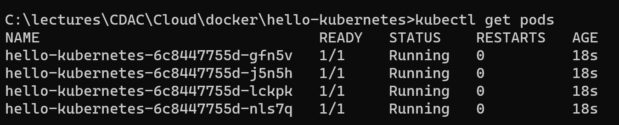
Run the YAML Configurtation
kubectl apply -f deployment.yaml
Check pods: kubectl get pods

Slide 64

Test

Slide 65

Try deleting a pod
Command prompt 1
Command prompt 2

Slide 66
Deleting Everything (In case needed)
kubectl delete --all deployments
kubectl delete --all services
kubectl delete --all replicasets
If we want to only delete all pods
kubectl delete --all pods

Slide 67
Spring Boot Kubernetes Hands-on

Slide 68

Spring Initializr

Slide 69
C:\lectures\CDAC\Cloud\kubernetes\springboot-K8s-demo\src\main\java\com\example\demo\StudentKubernetesDemoApplication.java
package com.example.demo;
import org.springframework.boot.SpringApplication;
import org.springframework.boot.autoconfigure.SpringBootApplication;
@SpringBootApplication
public class StudentKubernetesDemoApplication {
public static void main(String[] args) {
SpringApplication.run(StudentKubernetesDemoApplication.class, args);
}
}

Slide 70
C:\lectures\CDAC\Cloud\kubernetes\springboot-K8s-demo\src\main\java\com\example\demo\controller\StudentController.java
package com.example.demo.controller;
import com.example.demo.entity.Student;
import com.example.demo.repository.StudentRepository;
import org.springframework.beans.factory.annotation.Autowired;
import org.springframework.web.bind.annotation.*;
import java.util.List;
import java.util.Optional;
import java.util.logging.Logger;
@RestController
@RequestMapping("/student-records")
public class StudentController {
@Autowired
private StudentRepository studentRepository;
private Logger logger = Logger.getLogger(StudentController.class.getName());
@PostMapping(value = "/student",produces = "application/json")
public Student saveStudent(@RequestBody Student student){
logger.info("Saving a new student");
Student student1 = studentRepository.save(student);
return student1;
}
@GetMapping(value = "/students",produces = "application/json")
public List<Student> getStudents(){
logger.info("Retrieving all students");
return studentRepository.findAll();
}
@GetMapping(value = "/students/{id}",produces = "application/json")
public Optional<Student> getStudent(@PathVariable("id") Integer id){
logger.info("Retrieving student by id");
return studentRepository.findById(id);
}
@DeleteMapping("/student/delete/{id}")
public void deleteStudent(@PathVariable("id") Integer id){
logger.info("Deleting student by id");
studentRepository.deleteById(id);
}
}

Slide 71
C:\lectures\CDAC\Cloud\kubernetes\springboot-K8s-demo\src\main\java\com\example\demo\entity\Student.java
package com.example.demo.entity;
import lombok.AllArgsConstructor;
import lombok.Data;
import lombok.NoArgsConstructor;
import javax.persistence.Entity;
import javax.persistence.GeneratedValue;
import javax.persistence.GenerationType;
import javax.persistence.Id;
@Data
@AllArgsConstructor
@NoArgsConstructor
@Entity
public class Student {
@Id
@GeneratedValue(strategy = GenerationType.AUTO)
private Integer studentId;
private String name;
private String email;
}

Slide 72
C:\lectures\CDAC\Cloud\kubernetes\springboot-K8s-demo\src\main\java\com\example\demo\repository\StudentRepository.java
package com.example.demo.repository;
import com.example.demo.entity.Student;
import org.springframework.data.jpa.repository.JpaRepository;
public interface StudentRepository extends JpaRepository<Student,Integer> {
}

Slide 73
C:\lectures\CDAC\Cloud\kubernetes\springboot-K8s-demo\build.gradle
plugins {
id 'org.springframework.boot' version '2.7.3'
id 'io.spring.dependency-management' version '1.0.13.RELEASE'
id 'java'
id 'application'
}
group = 'com.example'
version = '0.0.1-SNAPSHOT'
sourceCompatibility = '1.8'
configurations {
compileOnly {
extendsFrom annotationProcessor
}
}
repositories {
mavenCentral()
}
dependencies {
implementation 'org.springframework.boot:spring-boot-starter-data-jpa'
implementation 'org.springframework.boot:spring-boot-starter-web'
compileOnly 'org.projectlombok:lombok'
runtimeOnly 'com.h2database:h2'
annotationProcessor 'org.projectlombok:lombok'
testImplementation 'org.springframework.boot:spring-boot-starter-test'
}
tasks.named('test') {
useJUnitPlatform()
}
application {
mainClass = 'com.example.demo.StudentKubernetesDemoApplication'
}

Slide 74

Build and Run
gradle compileJava
gradle run
Note the URL: localhost:8080/student-records/student (Because of the additional @RequestMapping annotation in the controller

Slide 75

Test

Slide 76

Build a Docker image – Create a JAR file first
C:\lectures\CDAC\Cloud\kubernetes\springboot-K8s-demo>gradle build

Slide 77
Dockerfile
FROM openjdk:8
ADD ./build/libs/demo-0.0.1-SNAPSHOT.jar demo-0.0.1-SNAPSHOT.jar
ENTRYPOINT ["java","-jar","/demo-0.0.1-SNAPSHOT.jar"]

Slide 78
Build Docker Image
C:\lectures\CDAC\Cloud\kubernetes\springboot-K8s-demo>docker build -t student-kubernetes-demo .

Slide 79

Make sure Kuberenets in Docker Desktop is Running

Slide 80
C:\lectures\CDAC\Cloud\kubernetes\springboot-K8s-demo\deployment.yaml
apiVersion: v1 # Kubernetes API version
kind: Service # Kubernetes resource kind we are creating
metadata: # Metadata of the resource kind we are creating
name: student-kubernetes-demo
spec:
selector:
app: student-kubernetes-demo
ports:
- protocol: "TCP"
port: 8080 # The port that the service is running on in the cluster
targetPort: 8080 # The port exposed by the service
type: LoadBalancer # type of the service. LoadBalancer indicates that our service will be external.
---
apiVersion: apps/v1
kind: Deployment # Kubernetes resource kind we are creating
metadata:
name: student-kubernetes-demo
spec:
selector:
matchLabels:
app: student-kubernetes-demo
replicas: 2 # Number of replicas that will be created for this deployment
template:
metadata:
labels:
app: student-kubernetes-demo
spec:
containers:
- name: student-kubernetes-demo
image: student-kubernetes-demo # Image that will be used inside the container in the cluster
imagePullPolicy: IfNotPresent

Slide 81

Deploy the YAML file
C:\lectures\CDAC\Cloud\kubernetes\springboot-K8s-demo>kubectl apply -f deployment.yaml

Slide 82

Verify the Deployment
kubectl get pods

Slide 83

Verify the Deployment
kubectl get services

Slide 84

Test in Postman

Slide 85

Test in Postman

Slide 86
Replicaset and Deployment Demo

Slide 87


Basic tests
kubectl get all
kubectl get nodes

Slide 88

Run our earlier yaml file for ngnix server deployment
cd C:\lectures\CDAC\Cloud\kubernetes
kubectl apply -f nginx-deployment-withrolling.yaml

Slide 89

Verify
kubectl get all

Slide 90


Delete a pod and verify
kubectl delete pod testdeploy-586b7f8654-4629d
kubectl get all
Quickly created a new pod to replace the delete one (See age: 6 seconds)

Slide 91

Delete a replicaset and verify
kubectl delete rs testdeploy-586b7f8654
kubectl get all

Slide 92

Delete a replicaset and verify
kubectl get rs

Slide 93

Let us now upgrade version
First, check the current version
kubectl describe pods
We can also try kubectl describe rs and kubectl describe deployment to verify that all the three (pods, rs, deployment) contain environment: test as the common identifier

Slide 94


Change the version to 1.17 in the yaml file
Deploy this: kubectl apply -f nginx-deployment-withrolling.yaml
Check: kubectl get all

Slide 95

After some time …
First replicaset is empty and is replaced by the second one

Slide 96
Delete empty replicaset and verify
When we deleted a non-empty current replicaset, Kubernetes automatically recreated it; what about the empty one?
kubectl get rs
kubectl delete rs testdeploy-7f9d4f5cb9
kubectl get rs
What happens? Next slide …

Slide 97

Delete empty replicaset and verify

Slide 98

Verify
kubectl describe pods

Slide 99


Another interesting command
Set the version back to 1.16 and deploy again and check immediately
kubectl apply -f nginx-deployment-withrolling.yaml
kubectl get rs --watch

Slide 100
Service

Slide 101

Sample application
Suppose we have two nodes, one for our web server and the other for our database server
Each has two pods for availability reasons

Slide 102

A DB pod fails
The failed DB pod will be replaced by a new DB pod by Kubernetes
However, the web server pod will not be able to use the new pod, since the IP address for the new DB pod will be different

Slide 103

A node fails
Now the situation is even worse …

Slide 104

Problem solved …

Slide 105

If new pods or nodes come up, they will be used automatically

Slide 106

We need to give labels to the pods to enable a service to discover them

Slide 107
Types of Service
LoadBalancer
ClusterIP
Nodeport
We will discuss LoadBalancer

Slide 108

Linking the Deployment with the Service using their respective manifest files – 1

Slide 109

Result – 2

Slide 110


LoadBalancer Service demo
Assuming that our ngnix deployment is still running …
kubectl apply -f loadbalancer-service.yaml
kubectl get service

Slide 111

Service details
kubectl describe service lb-service
Cannot be accessed, as it does not have a public IP (will later try on Cloud)

Slide 112
Google Kubernetes Engine (GKE) – Kubernetes on GCP

Slide 113



Select a Project in GCP
Search for Kubernetes, enable it, and Create a Cluster, GKE Standard

Slide 114


GKE Cluster Setup
Give name and create

Slide 115

Open the Cluster and activate Google Cloud Shell

Slide 116


Connecting to the Cluster

Slide 117
Try kubectl
Create a deployment
kubectl create deployment hello-world-rest-api --image=in28min/hello-world-rest-api:0.0.1.RELEASE

Slide 118
Where is the Image coming from?
https://hub.docker.com/u/in28min
Let us expose the API
kubectl expose deployment hello-world-rest-api --type=LoadBalancer --port=8080

Slide 119



Check Deployment Status
Go to the main screen and click on Services and Ingress
Click on the Endpoints URL link

Slide 120

Test

Slide 121

Understanding what happens behind the scenes
Try a few commands
kubectl get pods
kubectl get replicaset
kubectl get deployment
kubectl get service
Sample output

Slide 122
Impact of commands
kubectl create deploymet -> Creates deployment, replicaset, pod
kubectl expose deploymet -> Creates service

Slide 123
Example from GCP
kubectl get pods –o wide

Slide 124

Understanding ReplicaSet
kubectl get replicaset
Says that we need one instance of this and one is available (So, ok)
Let us try deleting a running pod, i.e. instance, and see what happens
First, get its details: kubectl get pods -o wide

Slide 125
Understanding ReplicaSet
Let us delete the pod
kubectl delete pods hello-world-rest-api-687d9c7bc7-ts4q8
Check: kubectl get pods -o wide
The previous Pod got deleted, but a new one has started now

Slide 126

What about the Output in the URL?
It is running, too!
Why?
The replicaset constantly monitors the pods. When the required number goes below the desired number, it immediately starts new pod(s) to fulfil the requirements.

Slide 127

How to tell Kubernetes to have more pods in the replicaset?
kubectl scale deployment hello-world-rest-api --replicas=3
Verify now: kubectl get pods

Slide 128

Higher Value in Replicaset
kubectl get replicaset
If we want to trace all the steps: kubectl get events

Slide 129
Upgrading an Application to a Newer Version
When we want to deploy a new version of the application, we can set the image of the earlier deployment to a new image
This will cause the images in the replicaset to be terminated
A new replicaset will be created with new images, i.e. new pods for the new version of the code
Example follows

Slide 130

Upgrading an Application to a Newer Version
kubectl set image deployment hello-world-rest-api hello-world-rest-api=in28min/hello-world-rest-api:0.0.2.RELEASE

Slide 131

Upgrading an Application to a Newer Version
kubectl get rs
Note that version 1 replicaset has 0 pods now, version 2 replicaset has 3

Slide 132
Understanding Service
An abstract way to expose an application running on a set of Pods as a network service. (See next slide)
Kubernetes Pods are created and destroyed to match the desired state of your cluster. Pods are nonpermanent resources. If you use a Deployment to run your app, it can create and destroy Pods dynamically.
Each Pod gets its own (internal) IP address, however in a Deployment, the set of Pods running in one moment in time could be different from the set of Pods running that application a moment later.
Since Pods that are ephermeral can get created and destroyed, and their IP address are internal, how can the consumers access the pods?
Enter Services.

Slide 133

Service

Slide 134

Service Demo
Get the running Pods list: kubectl get pods -o wide

Slide 135

Service Demo
Let us delete one of the Pods: kubectl delete pod <pod id>
Recheck: kubectl get pods –o wide
Observation: The new (i.e. replacement) Pod has a new ID and a different IP address than the deleted Pod.

Slide 136
Summary: Job of a Service
Provide a consistent, same external interface to the consumers
Pods are destroyable entities – they are created and deleted as per the requirements
Pods have internal IP addresses
A service groups pods logically, and thus provides a consistent interface to the consumers
When is a service created? When we run a cubectl expose deployment command

Slide 137

Back to the UI …
Services and Ingress option
Click on hello-world-rest-api

Slide 138

Service Details

Slide 139

Search for load balancing in the search box

Slide 140

Frontend remains constant, backend may change

Slide 141
Check the Running Services
kubectl get services

Slide 142

Understanding Kubernetes Rollouts
When we release new versions of our software, we need to be able to add meaningful documentation
Normally, this does not happen
kubectl rollout history deployment hello-world-rest-api

Slide 143

Adding Details to Version Change
Suppose we are releasing version 3 of the software now
We can add --record=true parameter to our set image deployment command: (Deliberate mistake has been made)
kubectl set image deployment hello-world-rest-api hello-word-rest-api=in28min/hello-word-rest-api:0.0.3.RELEASE --record=true
Then check rollout history again

Slide 144


Test
Still version 2 – because it could not find the correct image

Slide 145

Correct the Error and Retry
kubectl set image deployment hello-world-rest-api hello-world-rest-api=in28min/hello-world-rest-api:0.0.3.RELEASE --record=true

Slide 146


Test

Slide 147

Rollback to a previous Version
kubectl rollout undo deployment hello-world-rest-api --to-revision=1

Slide 148


Test

Slide 149
Understanding YAML

Slide 150

YAML

Slide 151
Kubernetes YAML File Structure
apiVersion: <Kubernetes API version>
kind: <Type of object, e.g. pod>
metadata: <Data about the object>
spec: <Information about the object>

Slide 152
Sample YAML File (C:\lectures\CDAC\Cloud\pod.yaml)
apiVersion: v1
kind: Pod
metadata:
name: nginx
labels:
app: nginx
tier: frontend
spec:
containers:
- name: nginx
image: nginx

Slide 153


Creating a Pod using YAML
kubectl apply -f pod.yaml

Slide 154
EKS (Elastic Kubernetes Service) – Kubernetes on AWS

Slide 155
What is EKS?
AWS manages Kubernetes Control Plane (the main Kubernetes service)
Maintains high availability via multiple EC2 instances in multiple zones
Handles scaling
Provides automated version upgrades and patching
Integrated with the rest of AWS services

Slide 156

EKS High Level Architecture
These are master nodes. Three of them are created in three different AZs to ensure redundancy.
These are worker nodes. Customers manage them as per their application requirements.

Slide 157

High Level Flow

Slide 158

Ways to create an EKS Cluster

Slide 159

eksctl

Slide 160

Eksctl commands

Slide 161
Demo – Install AWS CLI and Configure (Optional, if not already done)
We will normally use eksctl to connect to AWS EKS, but since we can also connect through the AWS CLI, we shall study this option also.

Slide 162


Using AWS CLI
Download (https://aws.amazon.com/cli/) and install AWS CLI
Check version in command prompt:
Create a Access Key for a non-root user in IAM Console

Slide 163

Note the Access Key Id and Secret Access Key
You can download/copy-paste or download the CSV – They will not be shown again for this key
Back to command prompt to configure the CLI using these values

Slide 164

Testing CLI
Try a command such as aws iam list-users

Slide 165
Installing Eksctl

Slide 166
Installing Eksctl
https://docs.aws.amazon.com/eks/latest/userguide/eksctl.html
First install chocolatey
(In PowerShell opened in admin mode, run the command
Set-ExecutionPolicy Bypass -Scope Process -Force; [System.Net.ServicePointManager]::SecurityProtocol = [System.Net.ServicePointManager]::SecurityProtocol -bor 3072; iex ((New-Object System.Net.WebClient).DownloadString('https://community.chocolatey.org/install.ps1’))
Take a look at the Get-Execution-Policy related help on the same page above)

Slide 167
Create a EKS Cluster using eksctl

Slide 168

Create Cluster command
In PowerShell admin,
eksctl create cluster --name eksctl-test --nodegroup-name ng-default --node-type t3.micro --nodes 2
Warning: Takes 5-10 minutes

Slide 169

Using yaml file
What if we want to run the eksctl commands, but do not wish to type the whole command on the command line/powershell?
We can use a yaml file for configurations
Example: eksctl create nodegroup --config-file=eksctl-create-ng.yaml
We will not discuss nodegroups – They are an AWS-specific feature

Slide 170
eksctl-create-ng.yaml file (C:\lectures\CDAC\Cloud\kubernetes)
---
apiVersion: eksctl.io/v1alpha5
kind: ClusterConfig
metadata:
name: eksctl-test
region: us-west-2
nodeGroups:
- name: ng1-public
instanceType: t3.micro
desiredCapacity: 2
managedNodeGroups:
- name: ng2-managed
instanceType: t3.micro
minSize: 1
maxSize: 3
desiredCapacity: 2

Slide 171


How to verify the creation? – 1
In AWS browser window, go to CloudFormation -> Stacks
Make sure your region is the same as the region in which the Kubernetes cluster was created (view the log of the command in Powershell)

Slide 172

Verifying
eksctl get nodegroup --cluster=eksctl-test

Slide 173
Creating a Cluster using a yaml file, instead of adding parameters on the command prompt
eksctl create cluster --config-file=eksctl-create.cluster.yaml

Slide 174

Deleting a Cluster
First get cluster information: eksctl get cluster
Delete cluster: eksctl delete cluster --name=eksctl-test

Slide 175

Deploying a Pod
First create a namespace: kubectl create namespace eks-sample-app
A namespace allows us to group resources in Kubernetes
Create pods: kubectl apply -f nginx-deployment-withrolling.yaml and then verify using kubectl get pods
Note: eksctl is only for cluster management. For other commands, we need to use kubectl.

Slide 176
Next steps
You can try the steps we tried in local Kubernetes cluster now on AWS Kubernetes cluster
In the end, remember to delete the cluster!
eksctl delete cluster --name=eksctl-test

